Slide 1
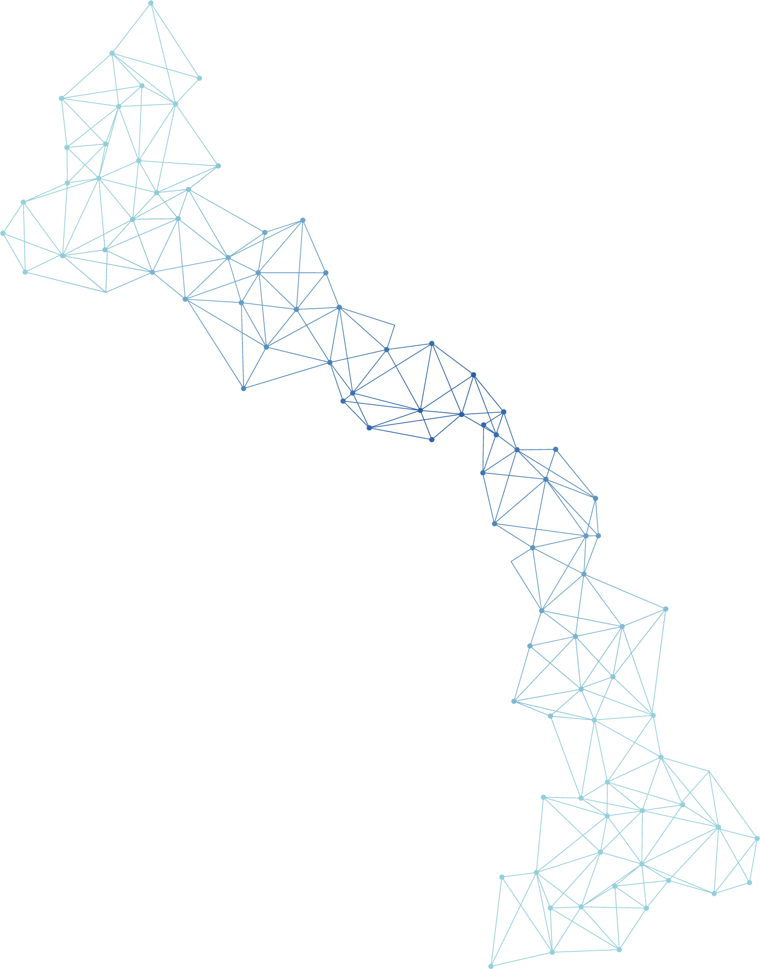

Quantum Innovation Challenge 2025
Quantum Neural Network-enhanced Residual Multi-Layer Perceptron Mixture-of-Experts (QNN-enhanced ResMLP_MoE)
Presenter: Seon-Geun Jeong
Team PNU: Pusan National University, Republic of Korea
Seon-Geun Jeong, Ph.D Candidate
Doan Hieu Nguyen, Ph.D Candidate
Le Tung Giang, Ph.D Candidate
Mai Dinh Cong, M.S. Candidate
Sanghun Sel, Ph.D Candidate
Juseong Kim, Ph.D Candidate
Min-Gyeol Kim, M.S. Candidate
Prof. Won-Joo Hwang
Prof. Giltae Song
Prof. In-Soo Yoon
Notes:
Good afternoon. I am Seon-Geun Jeong from Team PNU. We are delighted to have been selected as one of the top five finalist teams in the Quantum Innovation Challenge 2025. Team PNU consists of Prof. Won-Joo Hwang, Prof. Gil-Tae Song, and Prof. In-Soo Yoon, together with seven master’s and doctoral students.
In this challenge, to solve the challenge tasks, we proposed Quantum neural network-enhanced residual multi layer perceptron mixture of experts.

Slide 2
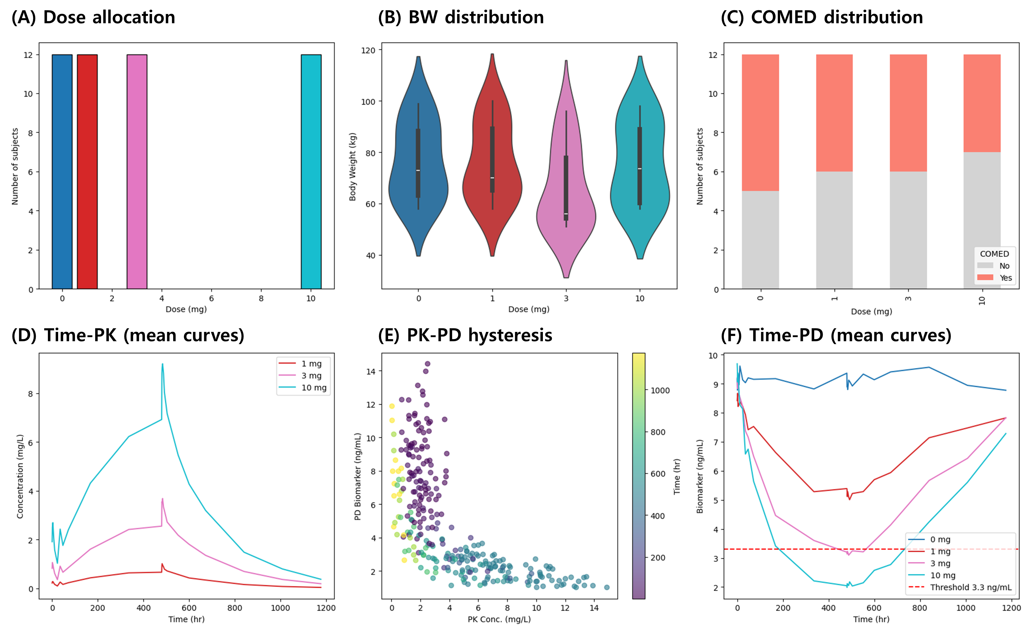
1. Dataset & Task
Task: 1) PK/PD modelling, 2) Dose optimization
Patient Data
Figure 1: Dataset.
Notes:
이 챌린지에서 저희는 PK/PD modelling을 하는 것과 Dose optimization 하는 것을 수행했습니다.
우선 저희는 환자들의 데이터 셋과 PK, PD를 먼저 분석하였습니다. 이 PK와 PD를 예측을 위하여 여러가지 구조들을 시도했었습니다.
In this challenge, our team focused on PK/PD modeling and dose optimization. First, we analyzed the patient dataset along with the pharmacokinetic (PK) and pharmacodynamic (PD) properties. To predict this PK and PD, we experimented with several different model architectures.

Slide 3
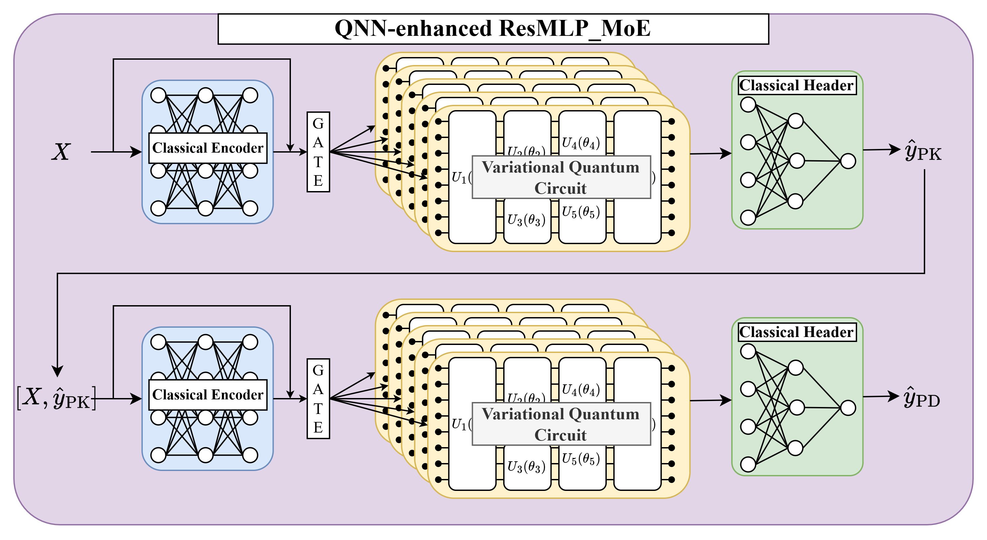
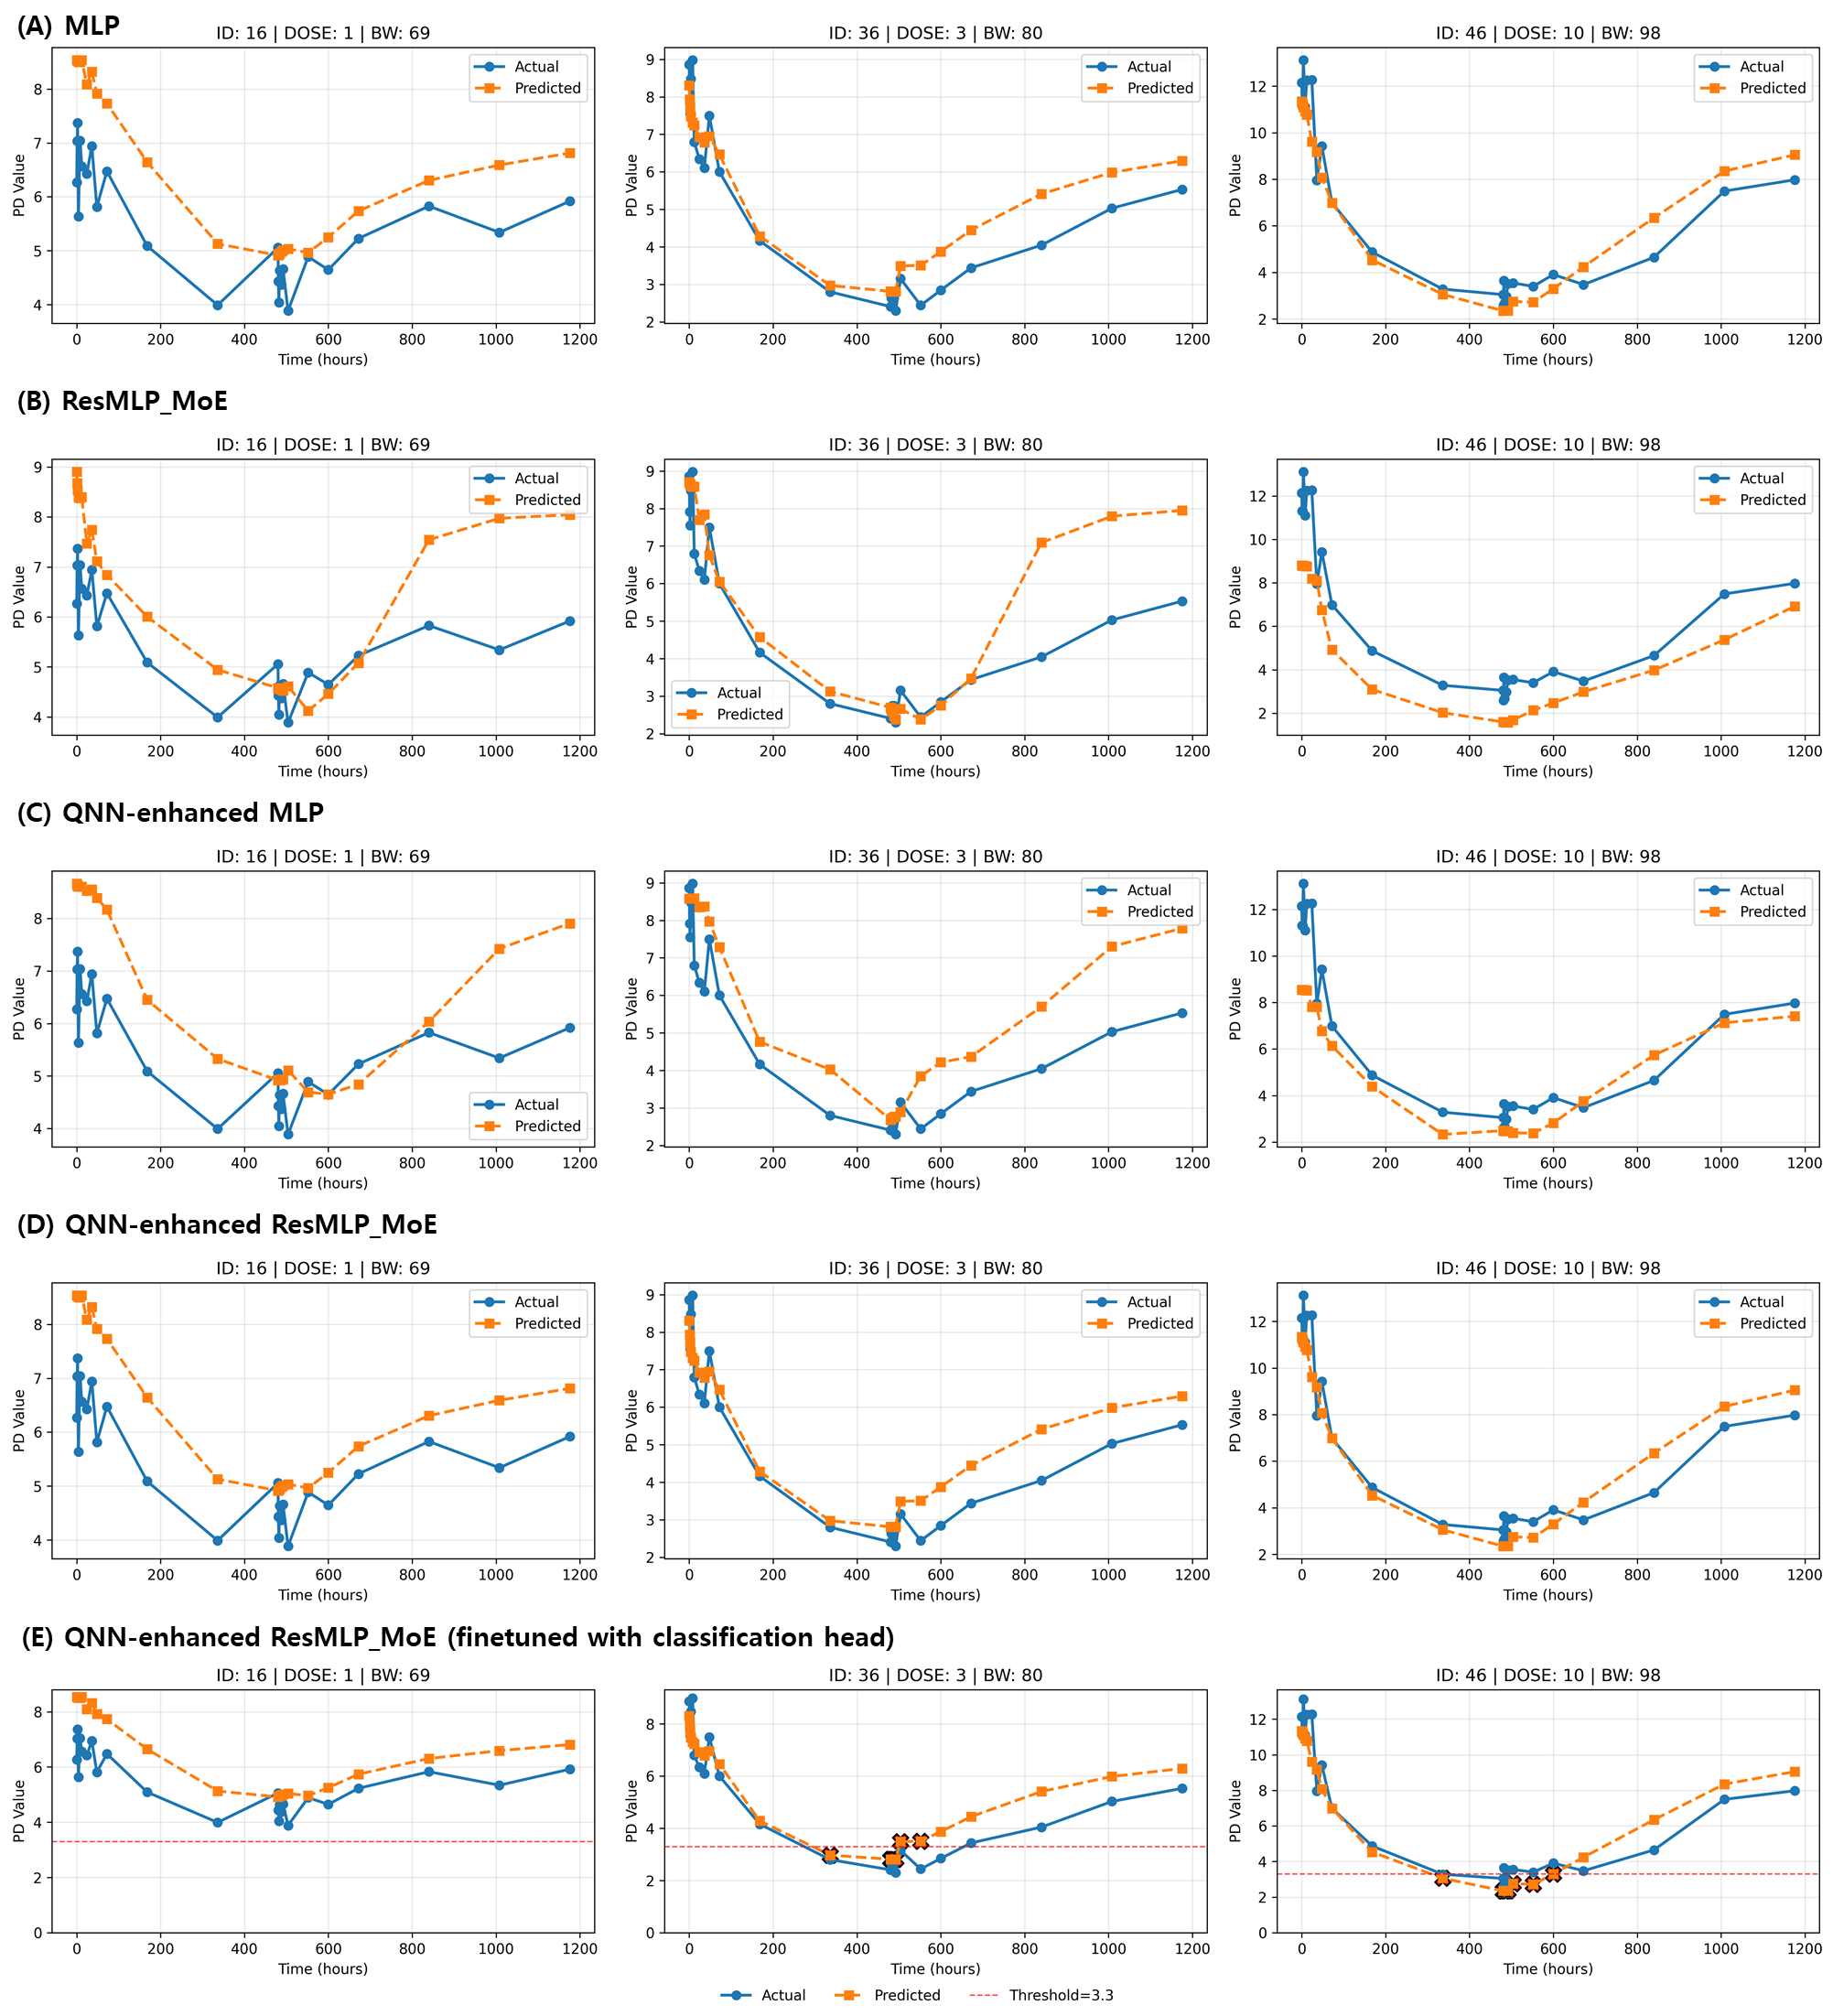
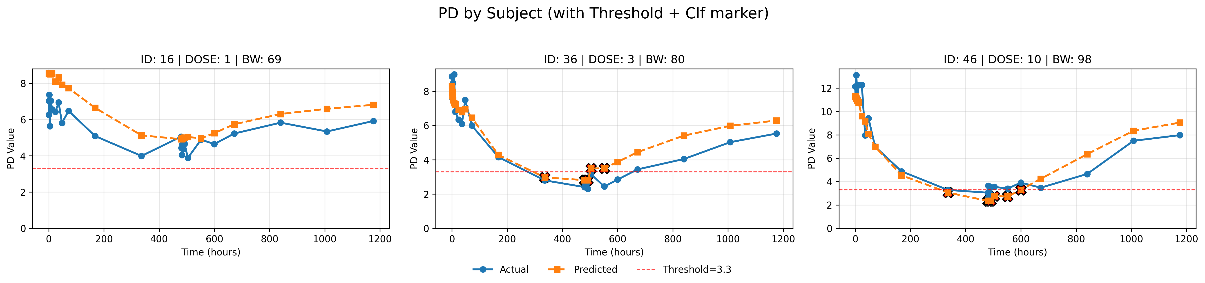


2. Quantum-enhanced ML Framework for Dose Optimization
QNN-enhanced ResMLP_MoE Framework
Input Data
PD value
Classical ML
Bio information
Patient ID
Weight..
Drug Information
Dose
Start Date
Time
PD value
Time (hours)
Quantum ML
Time (hours)
Clinically relevant threshold
Dose Optimization
Team PNU
Dose Optimization (Grid Search / MCTS)
Time-series simulation
(Prediction)
Prof. Giltae Song
Prof. Won-Joo Hwang
Prof. In-Soo Yoon
AI, Biomedical Data
Quantum Computing, AI
PK/PD, Biopharmaceutics
Choose candidate dose
Scoring
(Suppression)
Develops deep learning models for PK/PD prediction
Applies quantum algorithms to PK/PD modeling
Provides domain expertise in PK/PD and clinical pharmacology
Evaluate
& Update
Team Members:
Sanghun Sel, Juseong Kim, Mingyeol Kim
Team Members:
Seon-Geun Jeong, Le Tung Giang,
Nguyen Doan Hieu, Mai Dinh Cong
Specialized in clinical validation and dose optimization strategies
Notes:
In this challenge, we proposed a Quantum Neural Network–enhanced ResMLP_MoE framework for PK/PD prediction and dose optimization. Professor Giltae Song is an expert in bioinformatics and AI, Professor In-Soo Yoon is an expert in biopharmaceutics, and Professor Won-Joo Hwang is an expert in quantum AI. The specific tasks assigned to each expert in our framework are as follows. The input data first pass through a residual-structured classical encoder, and then multiple Quantum Neural Networks are connected in parallel in a Mixture-of-Experts configuration. The final classical header produces either PK or PD outputs, and by adopting a cascade structure, our model can jointly predict PK and PD. For dose optimization, we first generate several candidate dose levels. These candidates are then fed into our model to predict PD values, and we evaluate whether the predicted PD value is below the clinically relevant threshold of 3.3 ng/mL. Through this process, our framework identifies the optimal dose level for each patient.

Slide 4
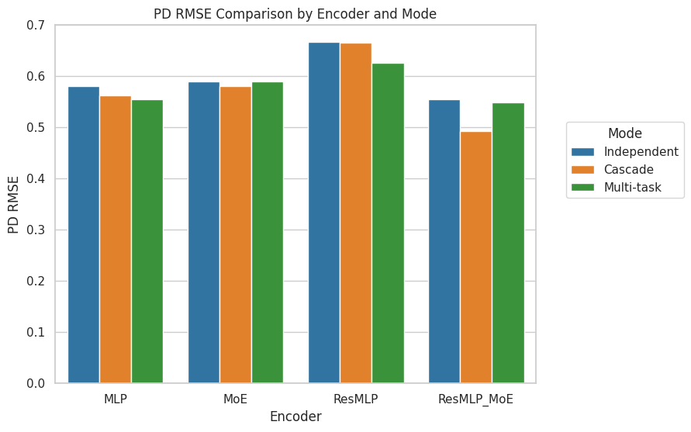
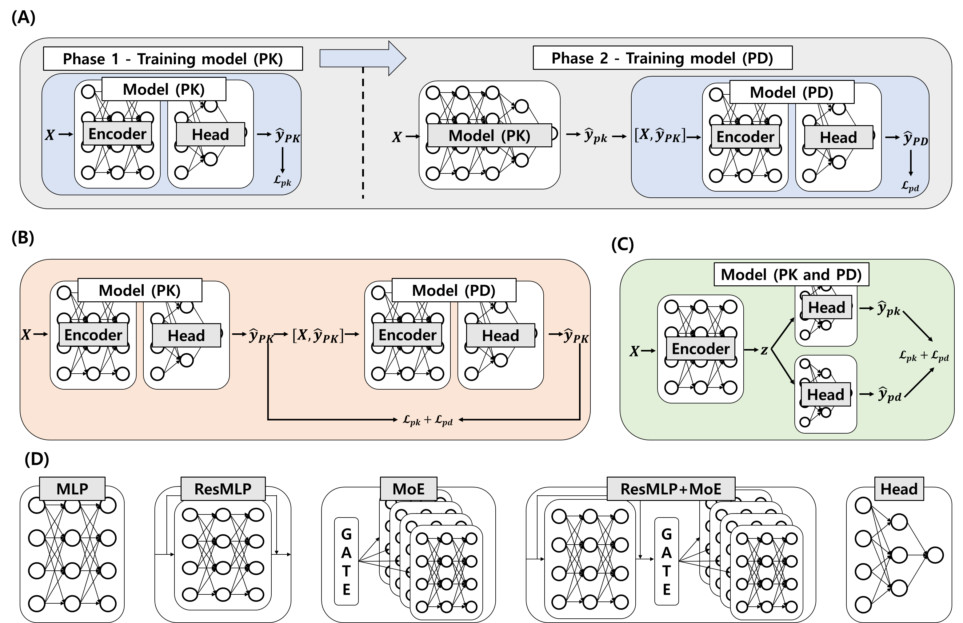
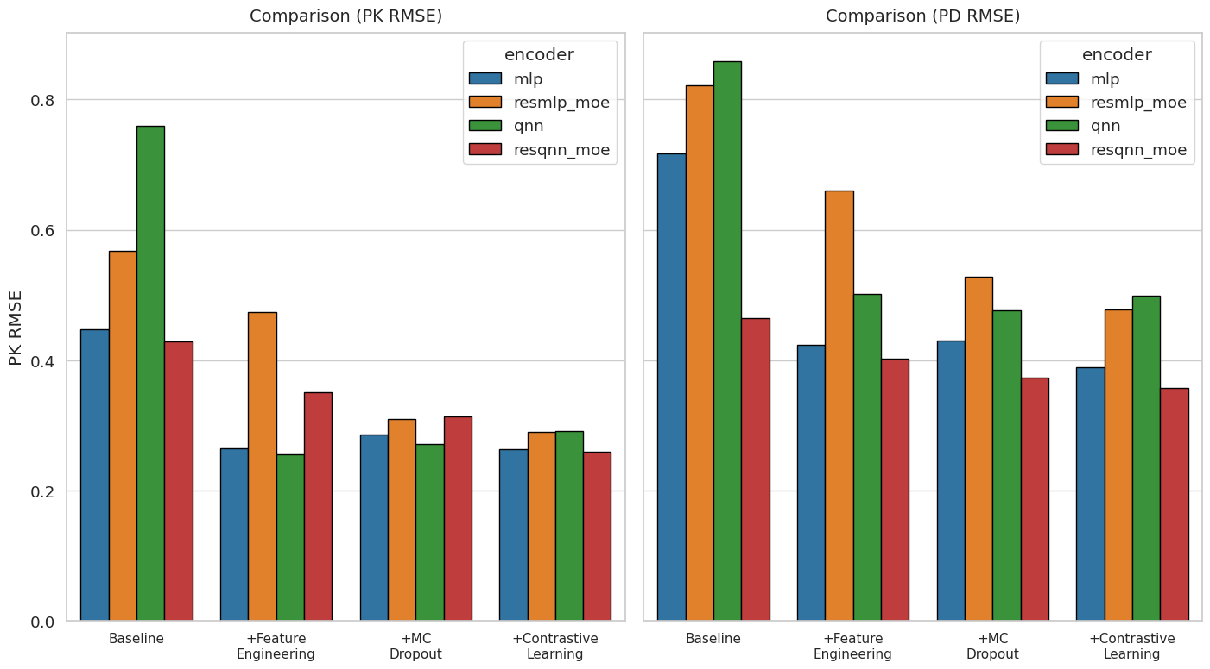
3. Model Search
Cascade + ResMLP+MoE achieves the best performance in terms of PK/PD RMSE.
Independent
Cascade
Multi-task
PD RMSE
Figure 3: QNN-enhanced ResMLP_MoE.
Independent modeling
MLP
MoE
ResMLP
ResMLP_MoE
Best
PK RMSE
PD RMSE
MLP
ResMLP_MoE
QNN
ResQNN_MoE
MLP
ResMLP_MoE
QNN
ResQNN_MoE
Cascade mode
Multi-task mode
RMSE
$${\hat{y}}_{PD}$$
Encoder Backbones
Baseline
+Feature Engineering
+MC
Dropout
+Constrative
Learning
Baseline
+Feature Engineering
+MC
Dropout
+Constrative
Learning
Best
Figure 5: Empirical evaluation results.
Best
Figure 4: Overview of modeling frameworks.
Notes:
여기서는 저희가 어떻게 이 모델을 구현하게 되었는지 보여드리겠습니다.
양자 머신러닝 모델을 개발하기 위해서 다양한 모델링을 시도했습니다.
Independent modeling은 PK와 PD를 따로 학습하는 것이고
Cascade mode는 예측된 PK로 PD를 연이어 예측하는 것입니다.
Multi-task mode의 경우 PK와 PD를 예측하는 두개의 헤드가 병렬로 존재합니다.
Encoder backnone의 경우 여러가지 backbone들을 후보로 두어 실험했습니다.
오른쪽 실험 결과를 보시면 Cascade에서 ResMLP_MoE가 best였으며 추가로 feature engineering, montecarlo dropout, constrative learning등 여러가지 기법들을 실험 했을 때
Constrative learning이 best였으며 이로 인해 저희는 최종적으로 QNN-enhanced ResMLP_MoE 모델을 채택하였습니다.
I will show how we implemented our model.
To develop the quantum machine-learning model, we explored multiple modeling strategies. Independent modeling trains PK and PD separately. Cascade model predicts PK first which is input of PD predictor. Multi-task model uses two parallel heads to predict PK and PD jointly. For the encoder backbone, each encoder is the candidate backbones. As shown in the results on the right, ResMLP_MoE achieved the best performance in the cascade setting. We also evaluated feature engineering, Monte Carlo dropout, and contrastive learning; among these, contrastive learning performed the best. Based on these findings, we finally adopted the QNN-enhanced ResMLP_MoE as our model.

Slide 5
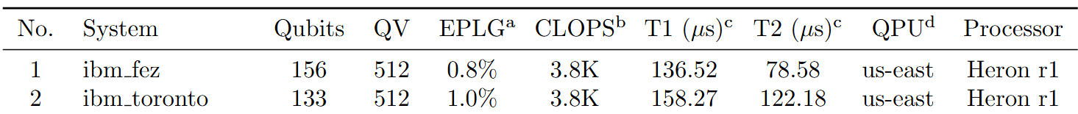
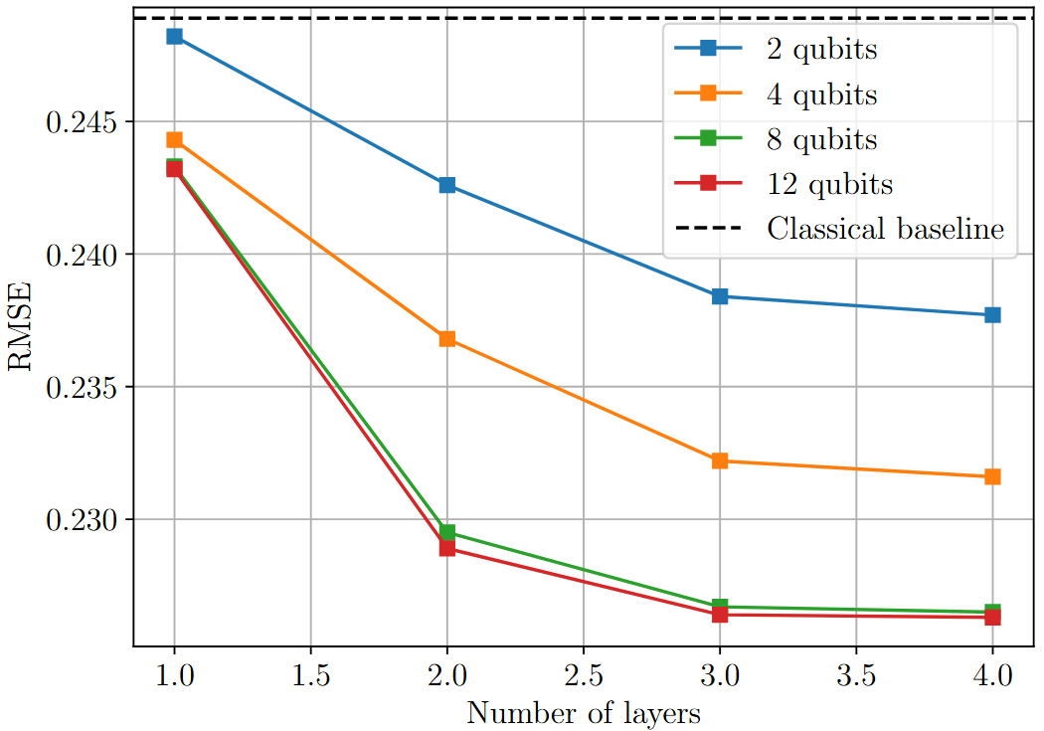
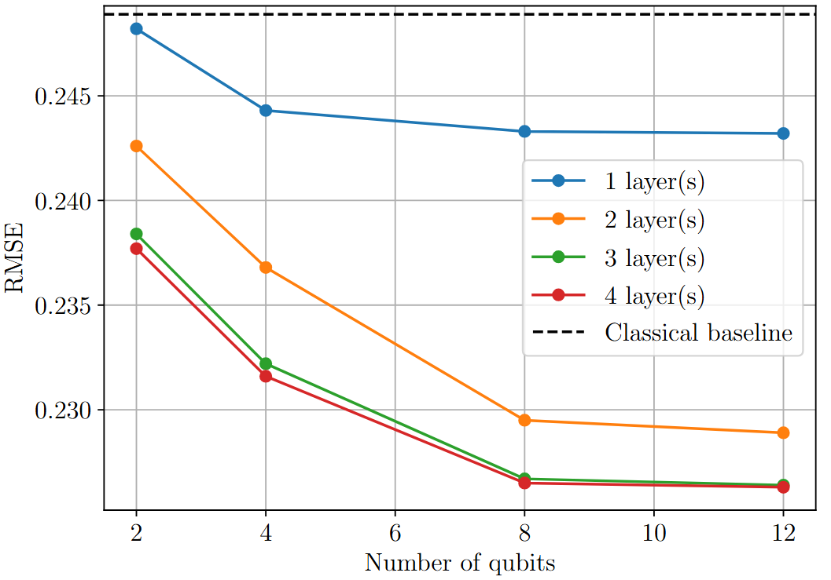
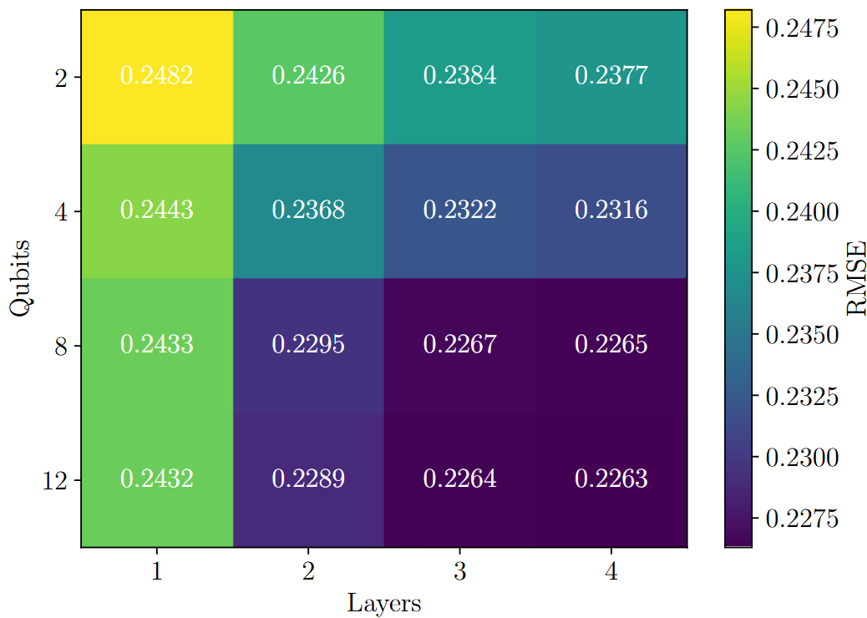
3. Quantum Model (Qubits, Layers, Advantage)
Technical Feasibility: Based on IBM quantum systems, the quantum volume reflects the maximum circuit size with widith $≈$ depth. State-of-the-arts $QV=512⇒T≤9$. That is, (9 qubits and 9 depth)
Table 1: The up-to-date IBM Quantum’s quantum computers
Figure 6: Results of QNN-enhanced ResMLP_MoE
[1] Jeong, Seon-Geun, Kyeong-Hwan Moon, and Won-Joo Hwang. "Hybrid quantum neural networks for efficient protein-ligand binding affinity prediction." EPJ Quantum Technology 12.1 (2025): 1-36.
Notes:
To consider the technical feasibility on real quantum computer, we assume that this model is implemented on IBM quantum computer.
We calculated the maximum circuit size and depth of quantum model based on IBM quantum computer spec.
So, we defined the maximum circuit size is 9 qubits and 9 depth.
Based on this setting, we conducted the simulations, then when we increase the number of qubits, the performance is increased.
Even if we design the 12 qubits system, its performance is similar with 8 qubits. This result is similar in number of layers case.
So, our model consists of 8 qubits and 4 layers.

Slide 6
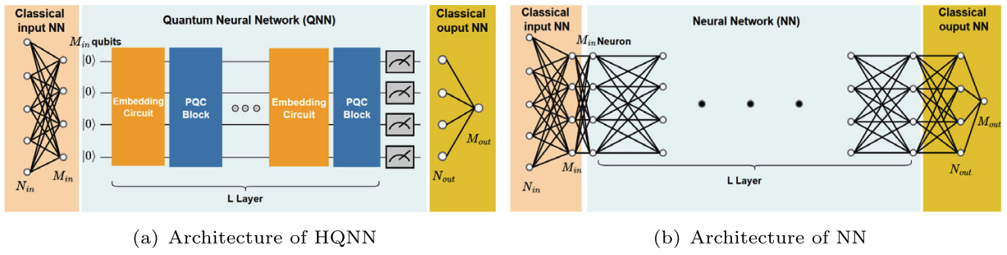

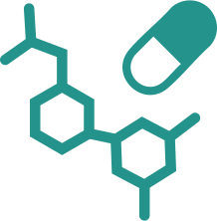


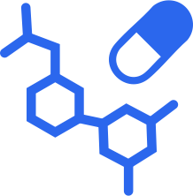




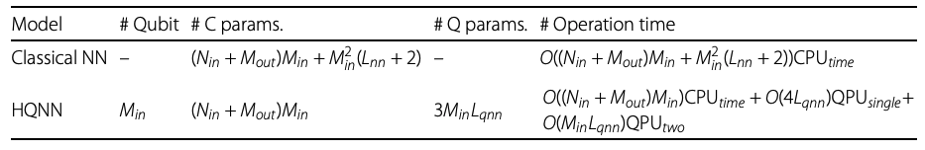
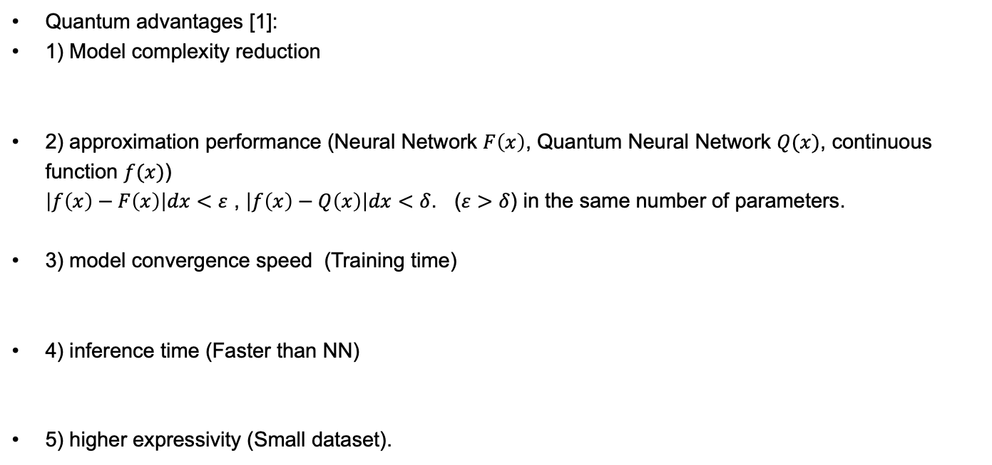
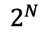
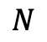
4. Conclusion
Quantum advantages [1]:
1) Model complexity reduction
2) approximation performance (Neural Network $F\left(x\right)$, Quantum Neural Network $Q(x)$, continuous function $f(x)$) $\left|f\left(x\right)−F\left(x\right)\right|dx<ε$ , $\left|f\left(x\right)−Q\left(x\right)\right|dx<δ$. ($ε>δ$) in the same number of parameters.
3) model convergence speed (Training time)
4) inference time (Faster than NN)
5) higher expressivity (Small dataset).
Mathematical
algorithm
CPU/GPU
Processing
Life Science
Task
Mathematical
Algorithm
Quantum
Processing
Life Science
Task
Time
Performance
Time
Performance
$$N$$
$$2^{N}$$
Classical representation Space
Quantum Hilbert representation Space
[1] Jeong, Seon-Geun, Kyeong-Hwan Moon, and Won-Joo Hwang. "Hybrid quantum neural networks for efficient protein-ligand binding affinity prediction." EPJ Quantum Technology 12.1 (2025): 1-36.
Notes:
I will finish this presentation by concluding the quantum advantage.
We expect there is the quantum advantage in terms of model complexity reduction, approximation performance, model convergence speed, inference time, and higher expressivity.
If we design the neural network and quantum neural network in the same number of parameters. We can reduce the depth. And in terms of approximiation performance, QNN is known as better than NN.
In the training, QNN converges faster than NN..
In the inference time, QNN is faster than NN.
For the representation space, the qubit can represent the input data in larger space.

Slide 7
Thank you!
Notes:
Thank you.

